Slide 1
FYP5: Object Detection, Tracking and Suspicious Activity Recognition for Maritime Surveillance using Thermal Vision

Slide 2
Weekly Tasks
STMNet (Initial Idea)
Linking Algorithm for Action Detection

Slide 3
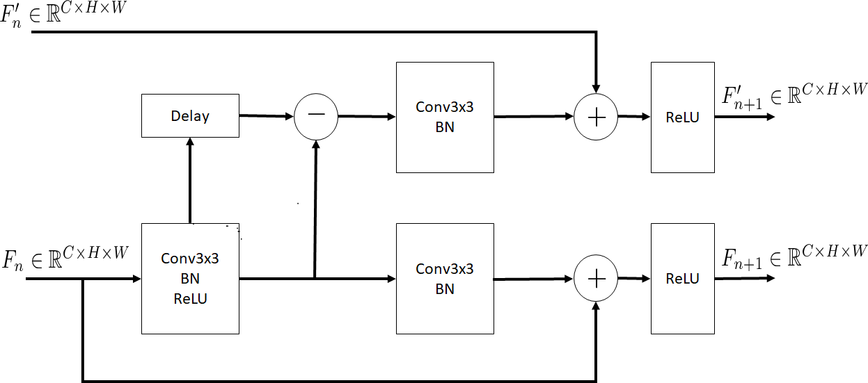
STMNet n^{th} layer Architecture

Slide 4
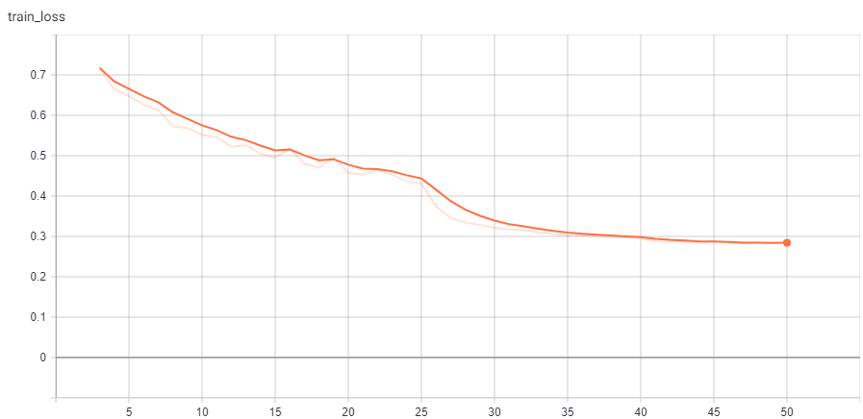
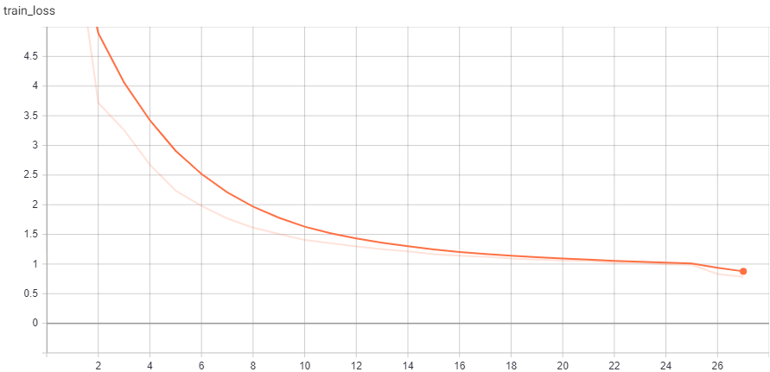
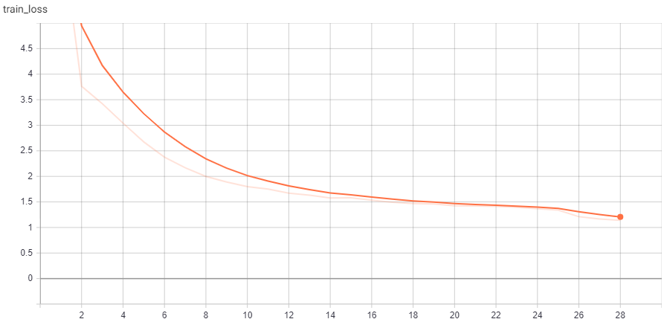
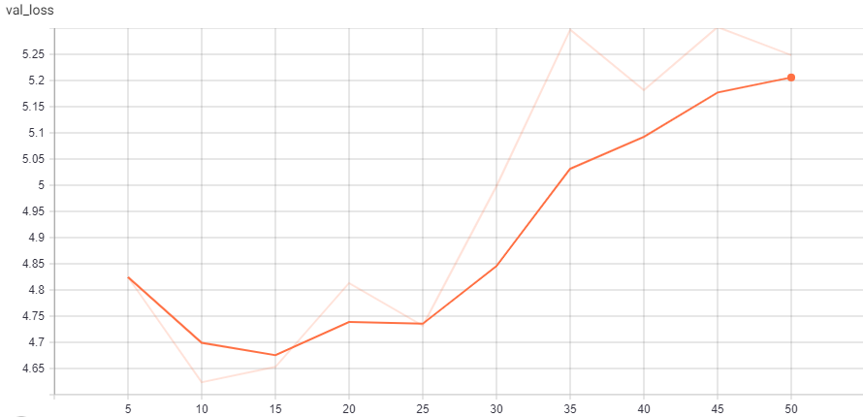
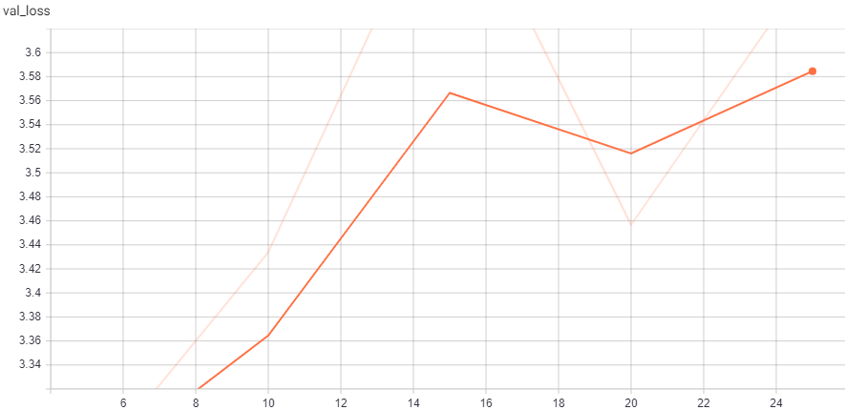
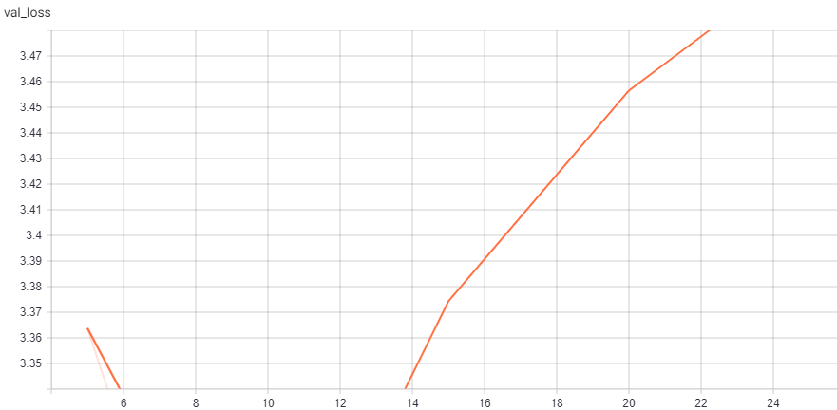
STMNet vs. ResNet on Action Classification on HMDB-21
ResNet | STMNet | STMTrack
39.0% | 33.4% | 27.5%

Slide 5
Tube Linking Algorithm
Finding Action Tubes (Georgia et al.)
Viterbi Algorithm
Dynamic programming
Deep Learning for Detecting Multiple Space-Time Action Tubes in Videos (Saha et al.)
Viterbi Algorithm
Temporal Trimming
Dynamic programming
Online Real-time Multiple Spatiotemporal Action Localization and Prediction (Singh et al.)
Online - Viterbi Algorithm
Greedy Algorithm
Temporal Trimming
Dynamic programming
Spatio-Temporal Instance Learning: Action Tubes from Class Supervision (Mettes et al.)
Temporal Prim

Slide 6
Other Ideas to Explore
Motion Vectors for Action Detection – improving the ICIP work replacing Optical Flow

